Slide 1
Section 06
Xiang Pan
11/06/2023

Slide 2
LLM Training
P A R T 0 1

Slide 3
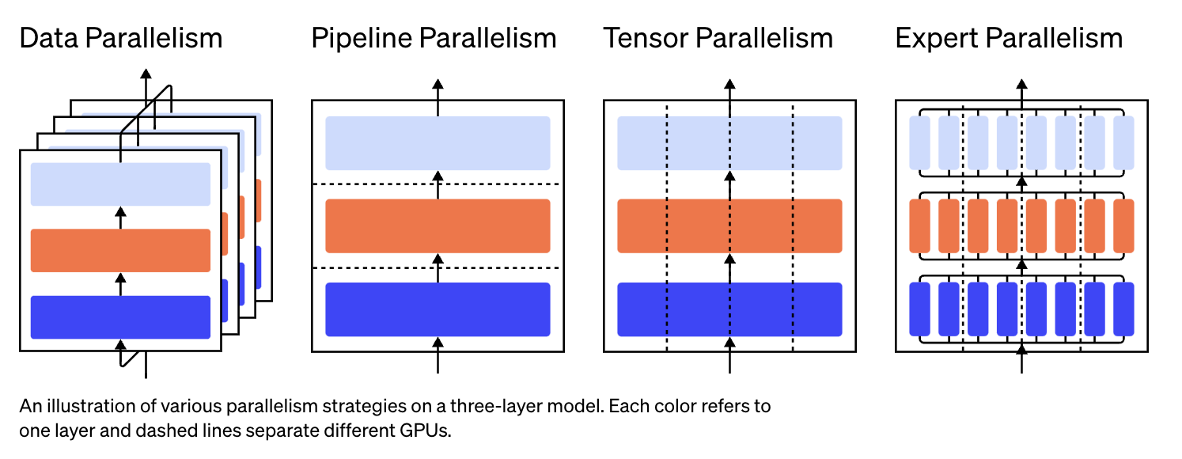
LLM Training
P A R T 0 1

Slide 4
Data Parallelism
P A R T 0 1
Model Fits into a single GPU memory
Keep multiple copies of parameters
Steps:
independently compute the gradient on each worker;
average the gradients across workers;
synchronous overhead!
asynchronous synchronization schemes?
independently compute the same new parameters on each worker.

Slide 5
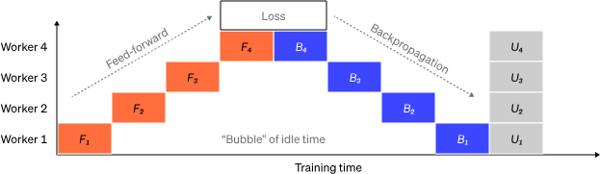
Pipeline Parallelism
P A R T 0 1
waiting for outputs from the previous machine

Slide 6
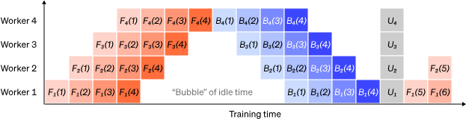
Pipeline Parallelism
P A R T 0 1
GPipe

Slide 7
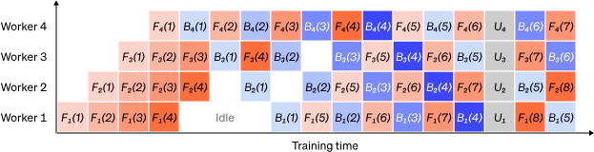
Pipeline Parallelism
P A R T 0 1
PipeDream

Slide 8
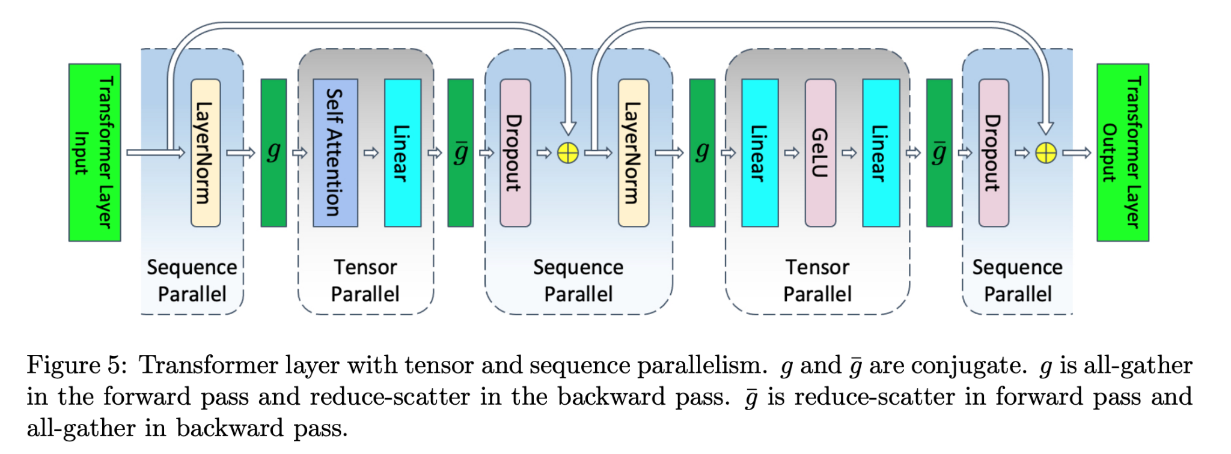
Tensor Parallelism
P A R T 0 1
Transformer/CNN -> Matrix Multiplication
Sequence parallelism:

Slide 9
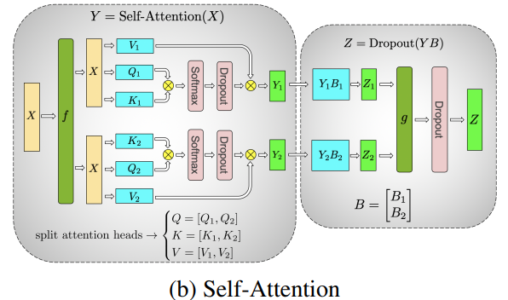
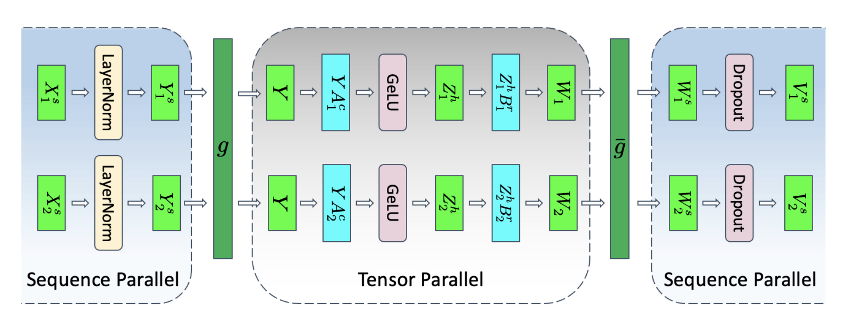
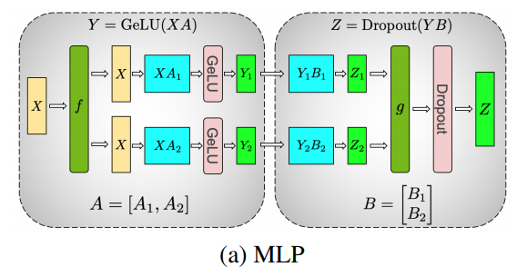
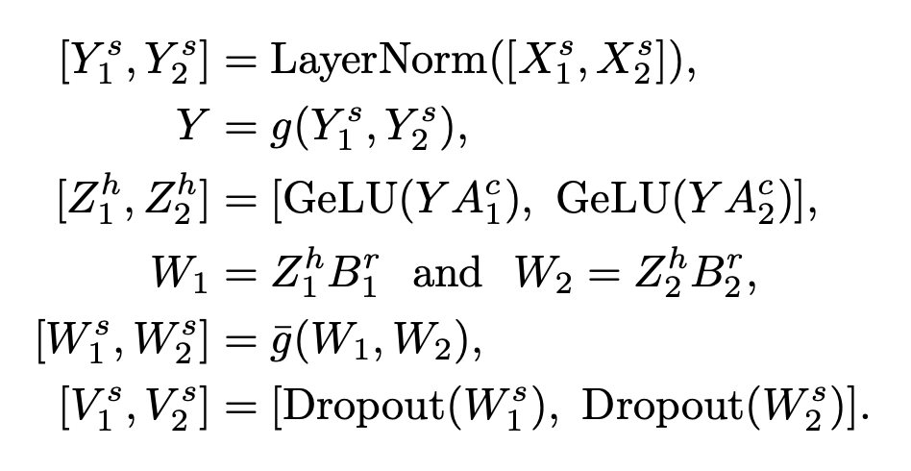
Tensor Parallelism
P A R T 0 1

Slide 10
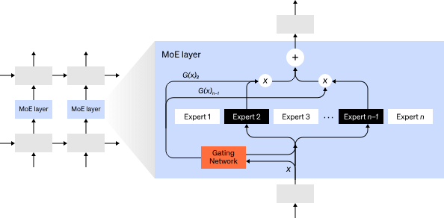
MOE
P A R T 0 1

Slide 11
Scaling Law for LLM Training
P A R T 0 2

Slide 12
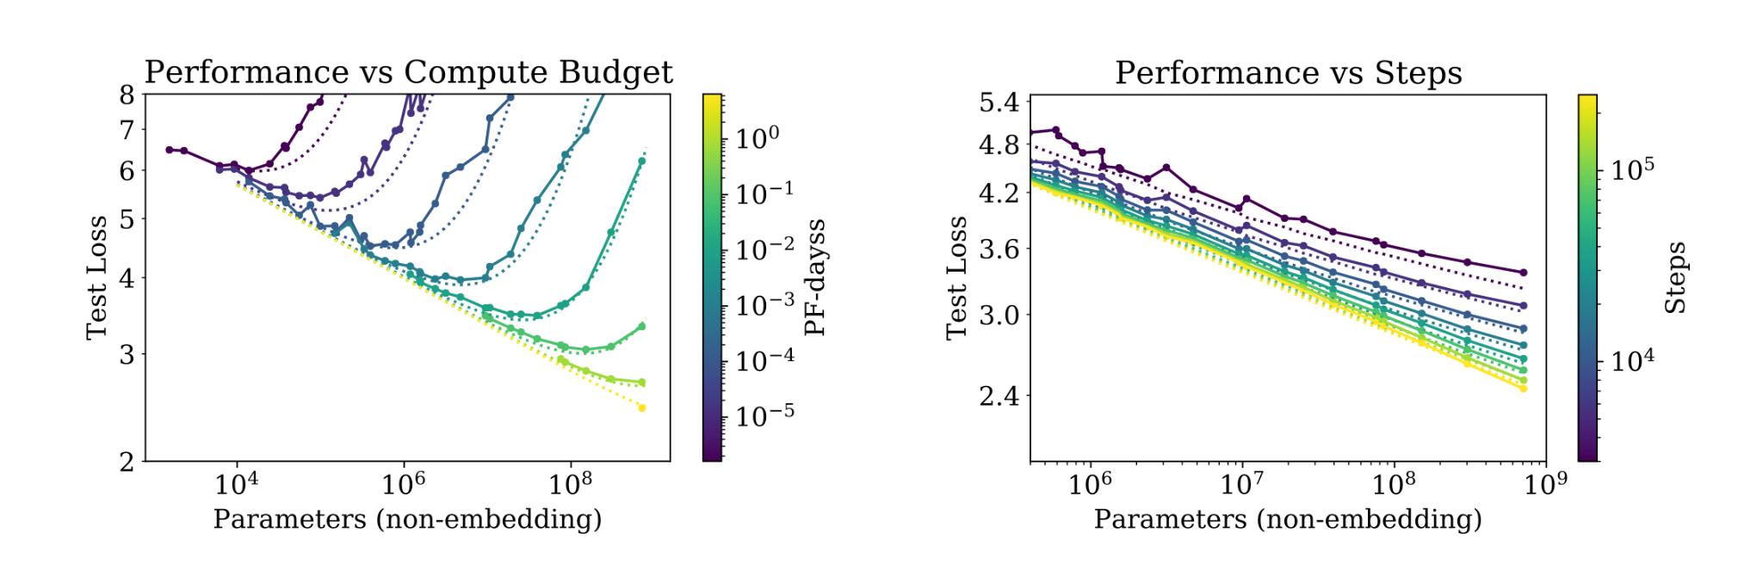
Scaling Law
P A R T 02
Why do we care about scaling law?

Slide 13
Optimal Configuration for LLM
P A R T 02
Given a fixed FLOPs budget, how should one trade-off model size and the number of training tokens?

Slide 14
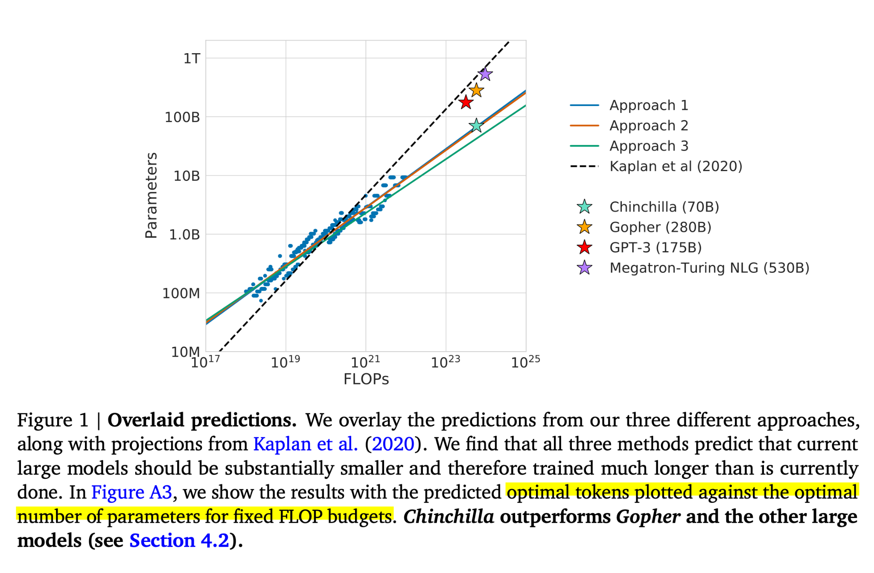
FLOPs (Token, Parameter)
P A R T 02
Approach 1: Fix model sizes and vary number of training tokens
Approach 2: IsoFLOP profiles
Approach 3: Fitting a parametric loss function

Slide 15
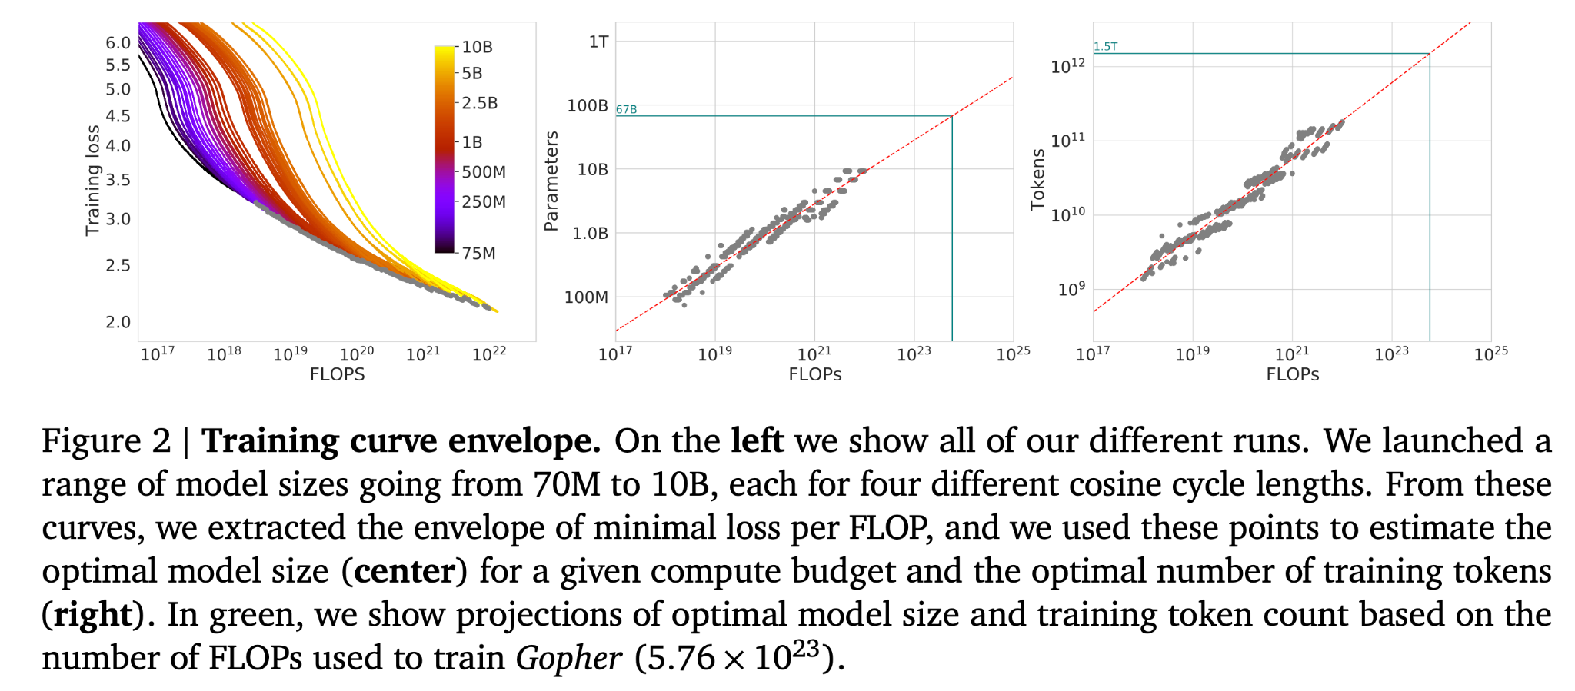
Approach 1: Fix model sizes and vary number of training tokens
P A R T 02

Slide 16
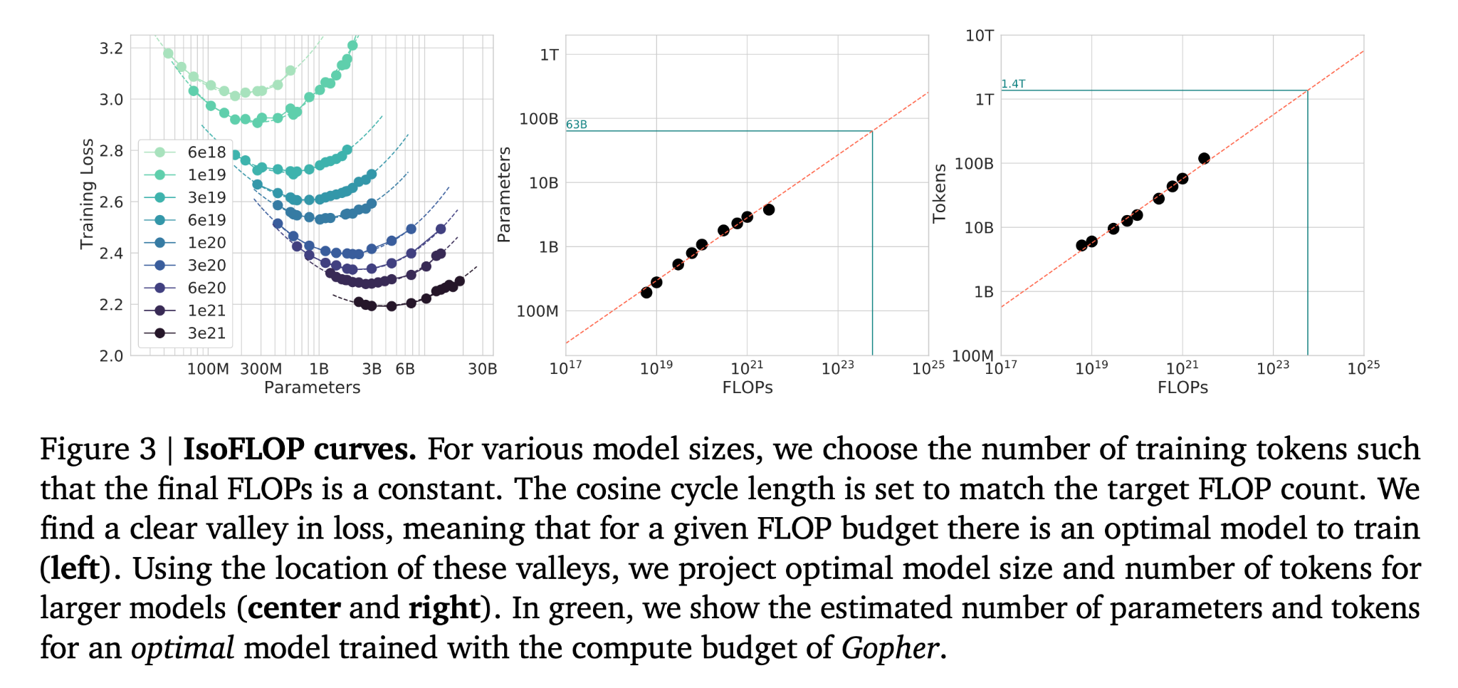
Approach 2: IsoFLOP profiles
P A R T 02
For a given FLOP budget, what is the optimal parameter count?

Slide 17
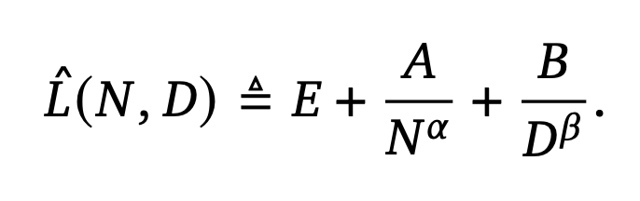
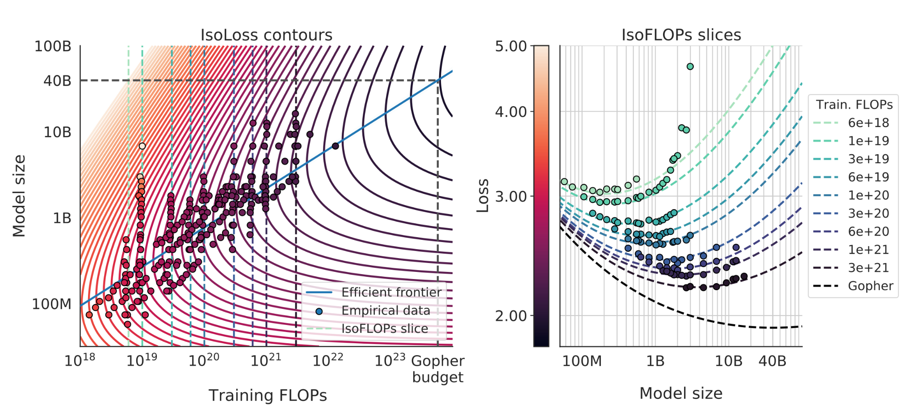
Approach 3: Fitting a parametric loss function
P A R T 02
N: Model Size
D: Token

Slide 18
FLOPs (Token, Parameter)
P A R T 02
Approach 1: Fix model sizes and vary number of training tokens
Approach 2: IsoFLOP profiles
Approach 3: Fitting a parametric loss function

Slide 19
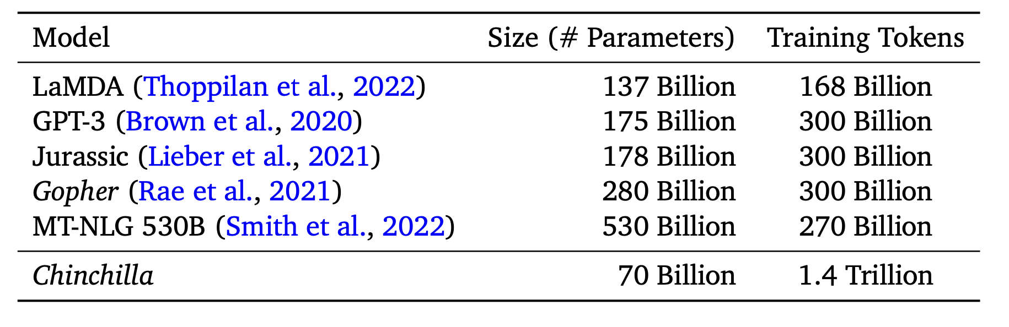
FLOPs (Token, Parameter)
P A R T 02

